Slide 1


Slide 2


WHO I AM

Slide 3

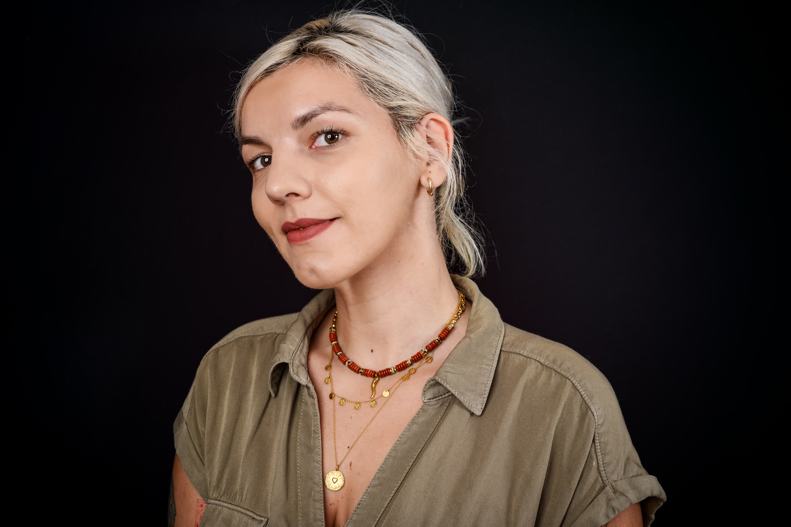
My name is Nadja. I was diagnosed with multiple sclerosis in March 2021, and I live in Niš, in southern Serbia.
Founded MS community: 300+ Discord members, created a neurologist map, organised a protest on World MS day, campaigner for invisible symptoms.
Also a member of Young People's Network, EMSP.
I am here today not only to speak from my own experience, but to bring the voices of my community.

Slide 4
THE SURVEY

Slide 5
Before coming to Berlin, I asked the people in my community one simple question: what does MS care actually look like in your life?
144 people responded - big cities, small towns,
villages across Serbia.
Two things define MS care in Serbia
more than anything else:
The first is access to a neurologist.
The second is information.

Slide 6
BARRIER 1:
ACCESS TO A NEUROLOGIST

Slide 7
Access to a neurologist is the #1 gap.
53% - named neurologist access as their biggest problem
80% said that the quality of their care depends on where they live.
35% had to travel to another city just to receive basic care - for a check-up, for an MRI, to pick up their medication.
The EMSP IMSS Serbia report found an average delay of 4.1 years between diagnosis and starting therapy. In my community,
one person waited 8 years.

Slide 8
Behind these numbers are real decisions people are making every day.
One person changed their home address to access therapy elsewhere!
One is considering moving to Belgrade: not for work, but for care!
One drives 150km every month for a routine appointment!
And from someone in southern Serbia: "There are a handful of neurologists covering the entire south of the country. Imagine how much time they have for each patient."
This is not a logistical inconvenience. This is a structural inequality that directly shapes the course of people's disease.

Slide 9
BARRIER 2:
LACK OF INFORMATION

Slide 10
40% named lack of information as a key gap.
Patients navigate the system alone - through Facebook groups, other patients, trial and error. Not through the healthcare system itself.
"I would have loved a simple leaflet at diagnosis - the most common questions, the most common symptoms, what happens next."
"My neurologist is brief in her answers. My information, like everyone else's, comes from Google."
"From the moment I got my diagnosis, I was left alone.
No one told me what MS is, what comes next, or where to go."

Slide 11
THE CONSEQUENCE:
YOU MUST BE LOUD

Slide 12
When care is inaccessible and information is absent patients must fill the gap themselves.
90% feel they must be stronger, louder,
or more informed to get adequate care.
What determines your care quality:
65% - personal resourcefulness
58% - city where you live
51% - personal connections
"If you are not assertive - you are invisible in the system."

Slide 13
DIGNITY

Slide 14
Only 11% always feel treated with dignity.
30% rarely or never do.
People described feeling like a number, like an inconvenience, like their arrival disrupts someone's day.
Dignity often depends on education, persistence, or personal connections
The same neurologist treats patients differently in private vs. state clinics
During a relapse, when patients are most vulnerable, the system is least responsive
"I feel like just another patient to get through, even though I carry something that will follow me for the rest of my life."
"When they hear I have a doctorate, they treat me slightly better."
"We are just a number. Nothing more."

Slide 15
EQUITABLE CARE

Slide 16
92% believe people with MS in Serbia
do NOT have equal access compared to EU countries.
The gap is not only about medication. It is about the entire experience of care.
What equitable care looks like from our community:
  A neurologist appointment you can actually schedule
  Therapy available in your own city
  Information on the day of diagnosis
  Psychological support as a standard, not a luxury
  Being treated as a person, not a case number
"We don't want privilege. We want the same doors that open for everyone else."

Slide 17
I want to close with something one person wrote when I asked what they would want European decision-makers to hear.
They wrote:
"When MS chose us as companions, it would be fair if the doors of support kept opening for us, instead of us constantly hitting a wall."
144 people shared their experiences so that their voices could be heard in this room today.
The barriers they face: to neurologists, to information, to dignity-
are not invisible.
They are documented. They are consistent.
And they are solvable.

Slide 18
Thank you!

